Slide 1
Hardware storage solutions

Slide 2
Direct Attached Storage (DAS)
Direct-attached storage (DAS) is a type of storage that is attached directly to a computer without going through a network.
The storage might be connected internally or externally.
Only the host computer can access the data directly. Other devices must go through the host computer to work with the data.
A direct-attached storage device is not networked.
An external DAS device connects directly to a computer through an interface such as Small Computer System Interface (SCSI), Serial Advanced Technology Attachment (SATA), Serial-Attached SCSI (SAS), FC or Internet SCSI (iSCSI).

Slide 3
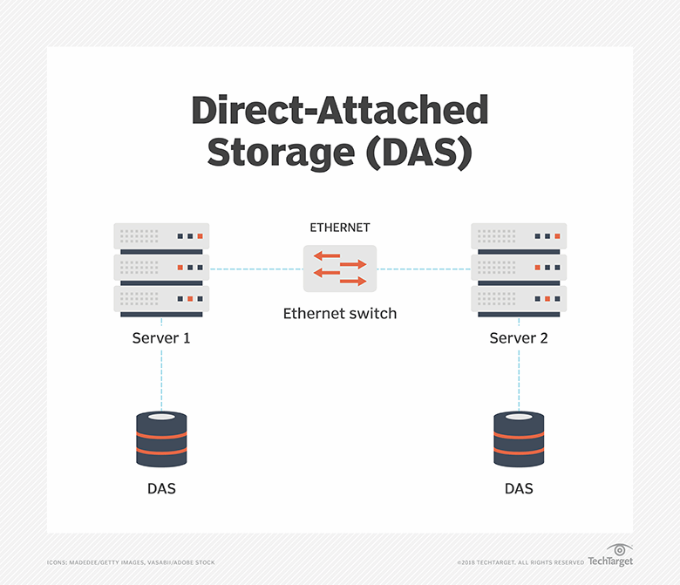
Direct-attached storage pros and cons
DAS can provide users with better performance than networked storage because the server does not have to traverse a network to read and write data.
DAS is also less complex than network-based storage systems.
It has limited scalability and lacks the type of centralized management and backup capabilities available to other storage platforms.
It can't be easily shared and doesn't facilitate failover should the server crash.

Slide 4
Network-Attached Storage (NAS)
Network-attached storage (NAS) is dedicated file storage that enables multiple users and client devices to retrieve data from centralized disk capacity.
Each NAS resides on the LAN as an independent network node, defined by its own unique IP address.
It can also serve emails, multimedia files, databases and printing jobs.
NAS stands out for its ease of access, high capacity and low cost.
NAS performance can be severely impacted if users overwhelm the system and the disk competes for input and output resources.

Slide 5
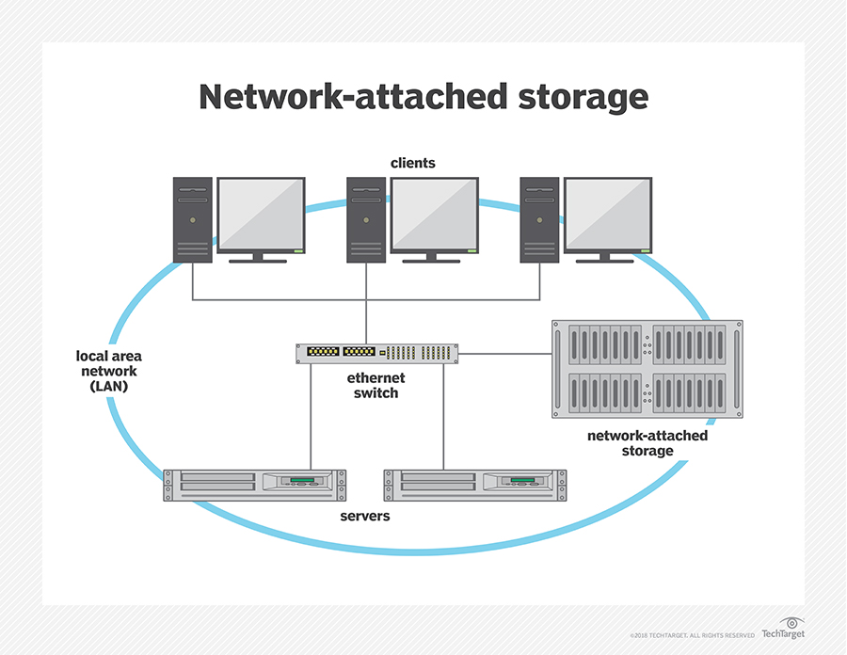
Organizations commonly deploy a NAS environment as a storage filer or the foundation for a personal or private cloud.
Some NAS products are designed for use in large enterprises. Others are for home offices or small businesses.
manage smart TV storage;
manage security systems and security updates;
manage consumer-based IoT components;
create a media streaming service;
manage torrent files;
At home, people use a NAS system to store and serve multimedia files and to automate backups. Home users rely on network-attached storage to do the following:

Slide 6
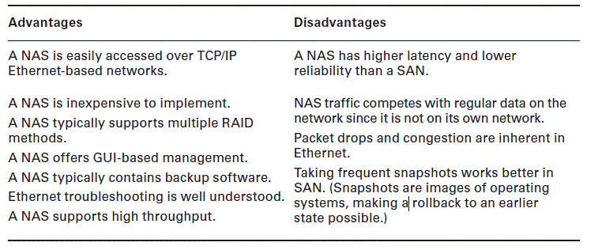

Slide 7
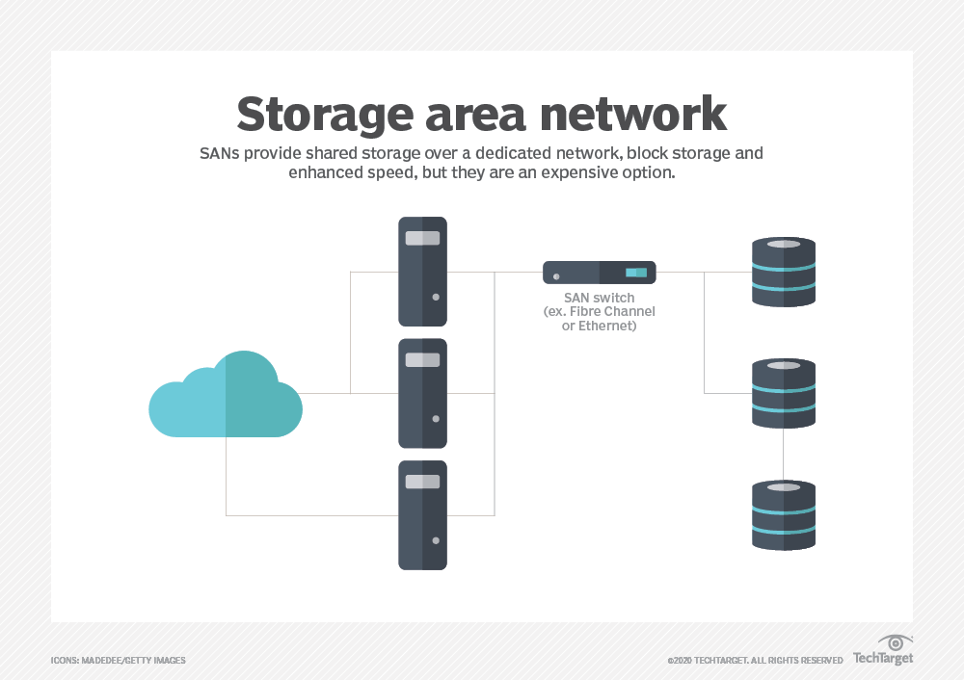
Storage Area Networks (SANs)
Classic storage area networks (SANs) consist of high-capacity storage devices that are connected by a high-speed private network (separate from the LAN) using a storage-specific switch.

Slide 8
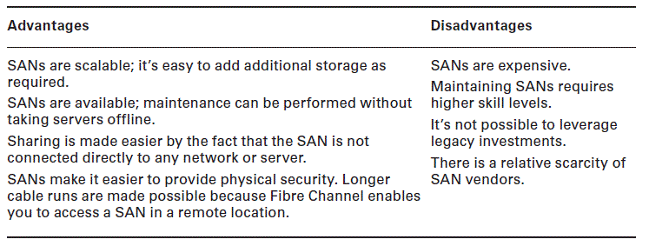
Pros and Cons.

Slide 9
Using iSCSI and FCoE
SANs can also be implemented in such a way that devices that cannot normally communicate by using the Fibre Channel protocol or SCSI commands can access the storage devices. Two technologies that make this possible are:-
iSCSI
Internet Small Computer Systems Interface (iSCSI) is an IP-based networking storage standard method of encapsulating SCSI commands (which are used with SANs) within IP packets.
FCoE
Fibre Channel over Ethernet (FCoE) encapsulates Fibre Channel traffic within Ethernet frames much as iSCSI encapsulates SCSI commands in IP packets.

Slide 10
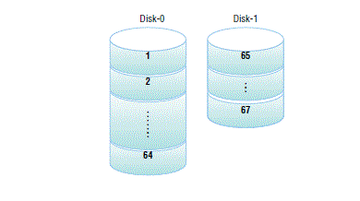
JBOD
JBOD refers to “just a bunch of disks”.
It is a cheaper alternative to a RAID system.
JBOD uses a process called concatenation.
There is no data redundancy, and regardless of the number of disks in the system, if the data is spanned across the disks, the loss of a single disk means the loss of all data, making backup extremely important.

Slide 11
Optical Drive
Servers may also have optical drives connected through SATA connections when the drives are internal or integrated. Alternatively, they may be external and connected with a USB connection.
These drives make it easy to install software on the server, transfer data easily, and perform backups.

Slide 12
Installing and Deploying Primary Storage Devices
When anticipating the installation or deployment of primary storage devices on servers, you should consider several factors before you even purchase the drives or drives.

Slide 13
Disk Specifications
RPM
Revolutions per minute (RPM) is a value that indicates how fast the drive spins. There is an inverse relationship between the RPMs and drive latency. Disk drives for servers typically have RPM values between 7200 and 15000.
Dimensions/Form Factor
The drive must fit into the bay in which it will be installed. The two most commonare the 2.5-inch small form factor (SFF) and the 3.5-inch large form factor (LFF).
Capacity
The amount of space you need will largely depend on the role the server is playing.

Slide 14
IOPS
Input/Output Operations per Second (IOPS) is a value that describes how fast the drive can read and write to the disk.
Latency
Latency is a measure of the time it takes the platter to spin the disk around so that the actuator arm is over the proper section. Latency is largely a function
of the RPMs as a faster spinning disk will arrive at the desired location faster than a slower disk

Slide 15
Interfaces
There are five major drive interfaces you may encounter when installing or swapping out disk drives—
SAS
SATA
SCSI
USB
Fibre Channel

Slide 16
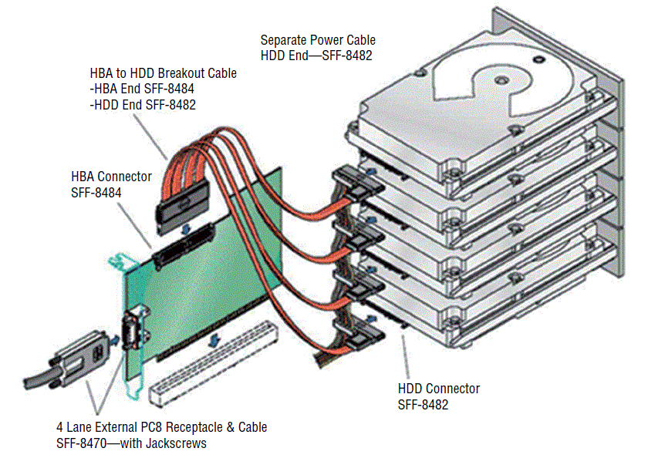
Serial Attached SCSI (SAS)
Serial Attached SCSI (SAS) is a type of SCSI that uses serial operation rather than parallel as the original SCSI did.
SAS uses point-to-point communication.
SAS requires no termination as in parallel SCSI.
SAS Cabling

Slide 17
Serial ATA (SATA)
Serial ATA (SATA) is also a serial communication method and began as an enhancement to the original ATA specifications, also known as IDE and, today, PATA.
Placing multiple bits of data in parallel and trying to synchronize their transmission.

Slide 18
SCSI
There are many versions of SCSI that differ in the width of the bus and the allowable length of the cables.
Internal parallel SCSI cables have two or more 50-, 68-, or 80-pin connectors attached.
External cables have 50- or 68-pin connectors at each end, depending on the specific SCSI bus width supported.
The latest version, Ultra 640 SCSI, can have only 16 devices on the bus and the cable cannot exceed 10 meters in length, but it can achieve 640 MBps

Slide 19
USB
USB can provide an interface to practically any type of device, including storage devices. This includes the ability to use special adapter cables to connect a SCSI drive to a USB 3.0 port.

Slide 20
Fibre Channel
These are used to connect devices in a high-speed fiber storage network.
These networks typically use a fiber switch with devices connected to the switch using Fibre Channel interfaces.
Servers will require some implementation of a fiber HBA. Each HBA has a unique World Wide Name (WWN), which like a MAC address uses an Organizationally Unique Identifier (OUI) assigned by the IEEE.

Slide 21
In which storage technology are all storages devices attached locally?
A. NAS
B. SAN
C. DAS
D. PAS

Slide 22
In which storage technology are all storages devices attached locally?
A. NAS
B. SAN
C. DAS
D. PAS
Answer :--One of the key features of DAS is that there is no network connection standing between the server and the storage, as is the case with SAN and NAS.

Slide 23
Which of the following is used as identifiers for host bus adapters?
A. MAC addresses B. World Wide Names
C. IP addresses
D. LUNs

Slide 24
Which of the following is used as identifiers for host bus adapters?
A. MAC addresses B. World Wide Names
C. IP addresses
D. LUNs
Answer--B. HBAs have World Wide Names (WWNs) that identify them, much like MAC addresses.

Slide 25
Which of the following is an IP-based networking storage standard method of encapsulating SCSI commands?
A. HBA
B. iSCSI
C. FCoE
D. Fibre Channel

Slide 26
Which of the following is an IP-based networking storage standard method of encapsulating SCSI commands?
A. HBA
B. iSCSI
C. FCoE
D. Fibre Channel
Answer--B. Internet Small Computer Systems Interface (iSCSI) is an IP-based networking storage standard method of encapsulating SCSI commands (which are used with storage area networks) within IP packets. This allows the use of the same network for storage as is used for the balance of the network.

Slide 27
Which of the following is the time it takes for the actuator arm to arrive at the proper location where the read or write will occur?
A. IOPS
B. RPMs
C. Seek time
D. Form factor

Slide 28
Which of the following is the time it takes for the actuator arm to arrive at the proper location where the read or write will occur?
A. IOPS
B. RPMs
C. Seek time
D. Form factor
Answer--C. Seek time is the time it takes for the actuator arm to arrive at the proper location where the read or write will occur.

Slide 29
Which of the following is the time it takes for the platter to spin the disk around so the actuator arm is over the proper section?
A. IOPS
B. RPMs
C. Seek time
D. Latency

Slide 30
Which of the following is the time it takes for the platter to spin the disk around so the actuator arm is over the proper section?
A. IOPS
B. RPMs
C. Seek time
D. Latency
Answer--D. Latency is a measure of the time it takes the platter to spin the disk around so the actuator arm is over the proper section. Latency is largely a function of the RPMs since a faster spinning disk will arrive at the desired location faster than a slower disk.

